Slide 1

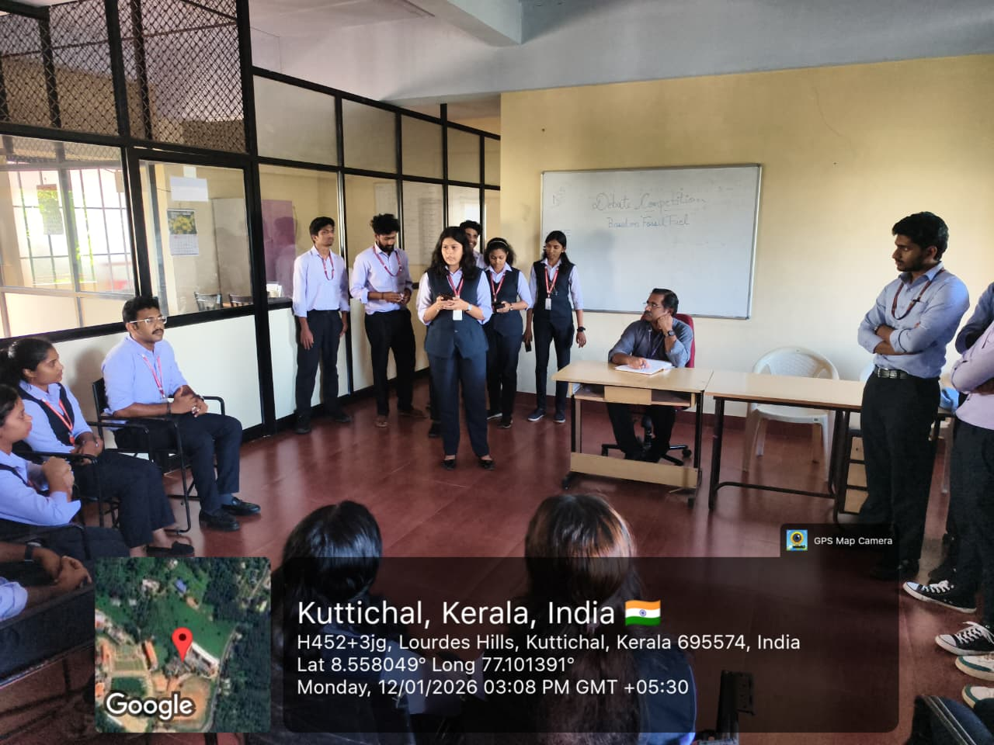
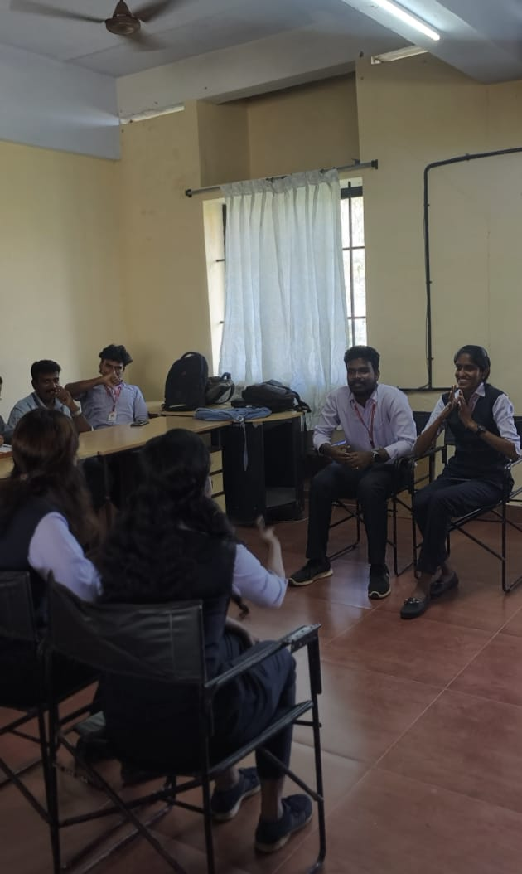
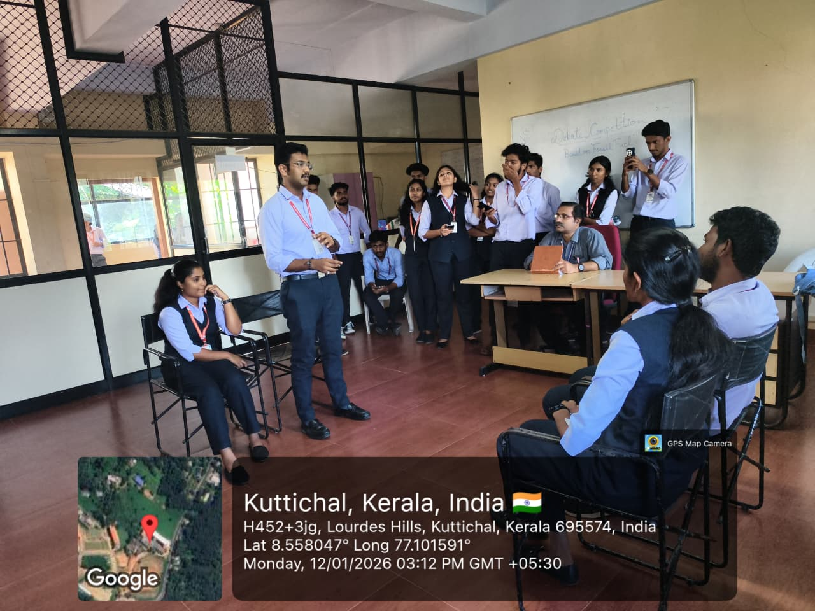
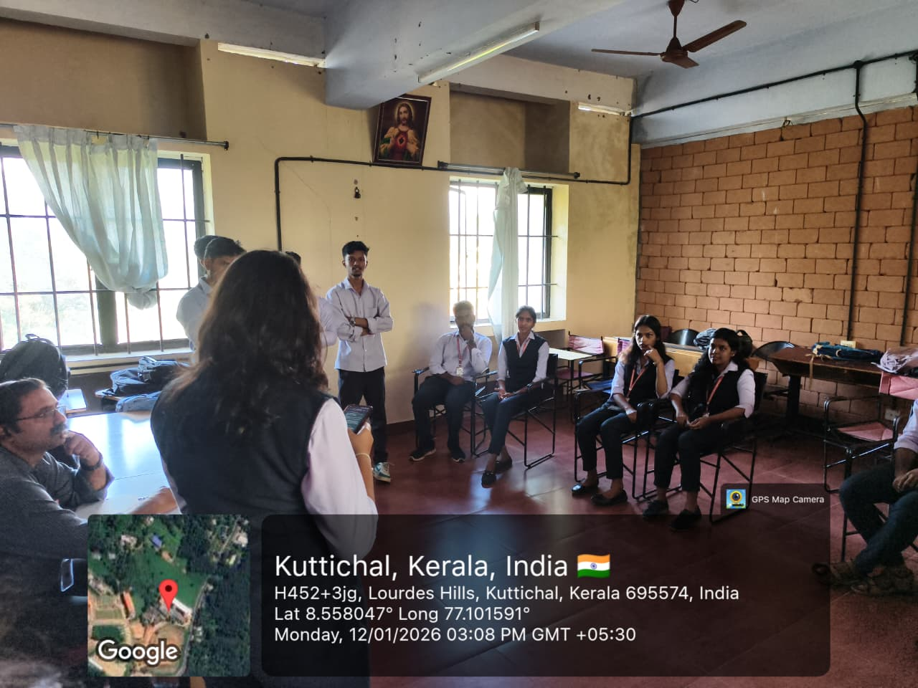
LOURDES MATHA COLLEGE OF SCIENCE AND TECHNOLOGY, KUTTICHAL, TRIVANDRUM
UNIT NO: 343
Date | 12/01/2026 | No of volunteers Participated:
Program | DEBATE COMPETITION
Highlights of program | A debate competition on “Phasing Out of Fossil Fuels” was held on 12th January 2026 at Lourdes Matha College, CE Department tutorial room, from 3:00 pm to 3:50 pm. The event aimed to create awareness about environmental sustainability and the need to reduce fossil fuel usage.The competition was conducted in a knockout format with four teams of two members each. Teams spoke for and against the motion, and the winners of the first round advanced to the final. The event was judged by Dr. Sunil J, HOD of the Civil Engineering Department, who evaluated the teams based on clarity, confidence, and subject knowledge.Elsy and Adarsh won the competition and were selected to represent the college at the Kerala State Students Energy Congress – 2026. The programme concluded with the announcement of results and a vote of thanks.

