Slide 1

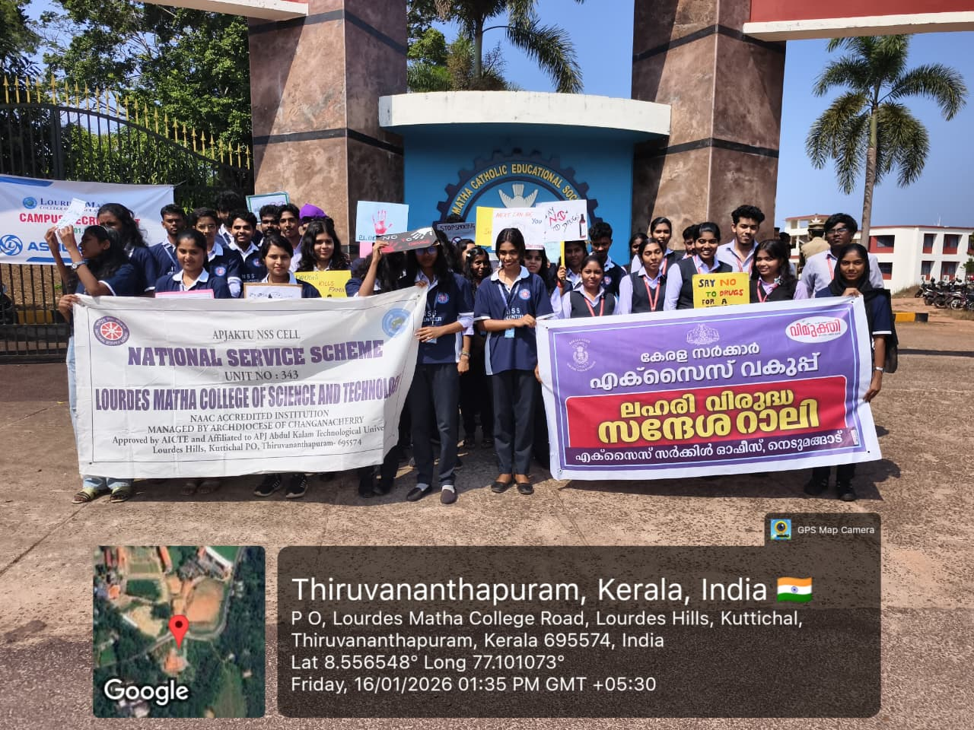
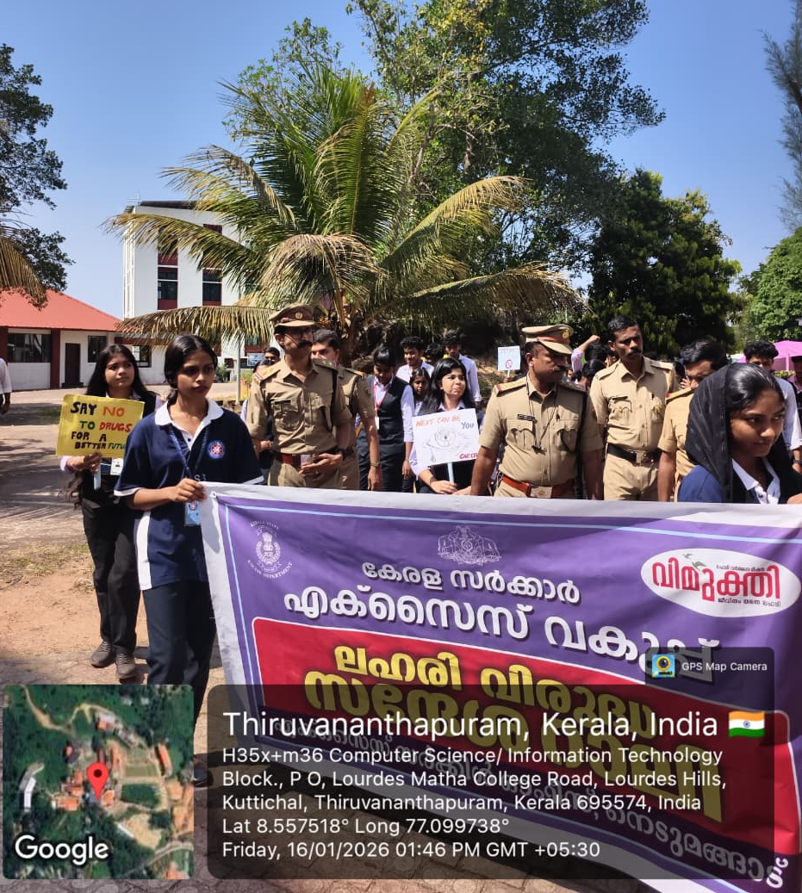
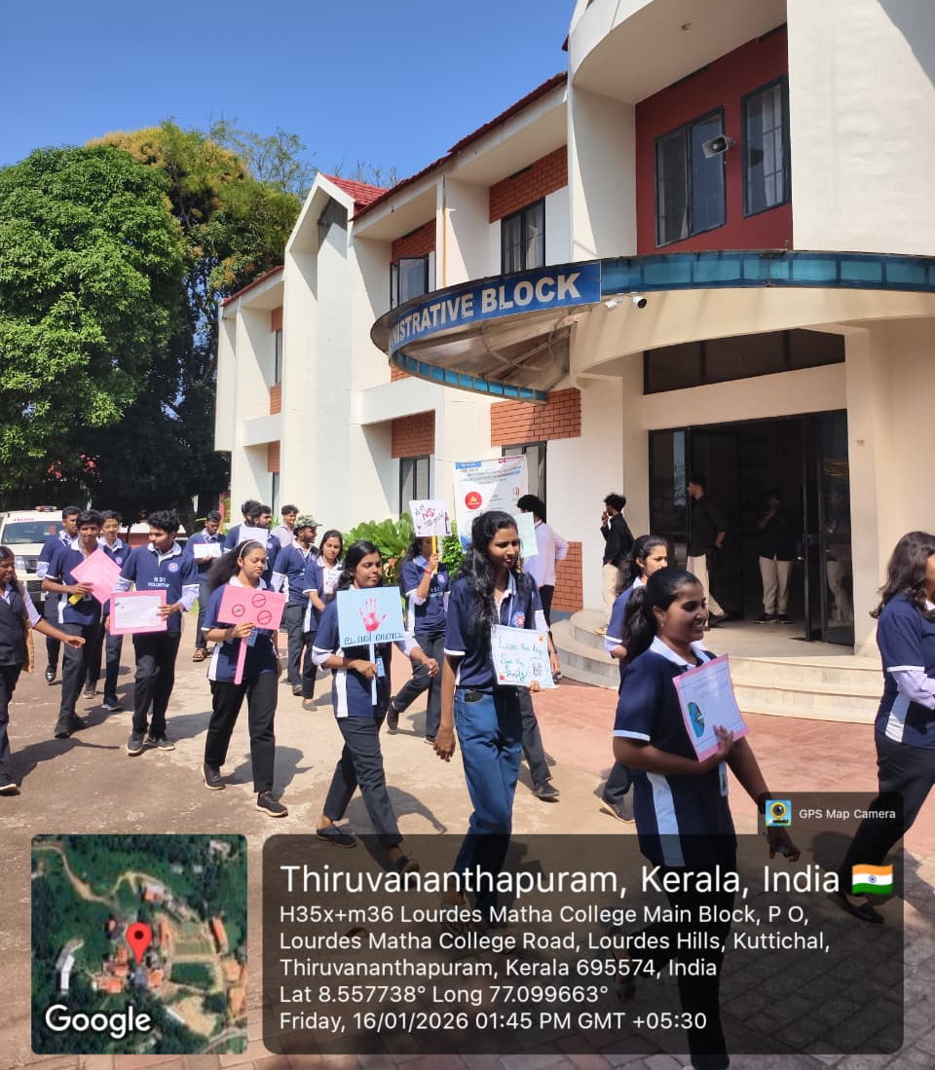
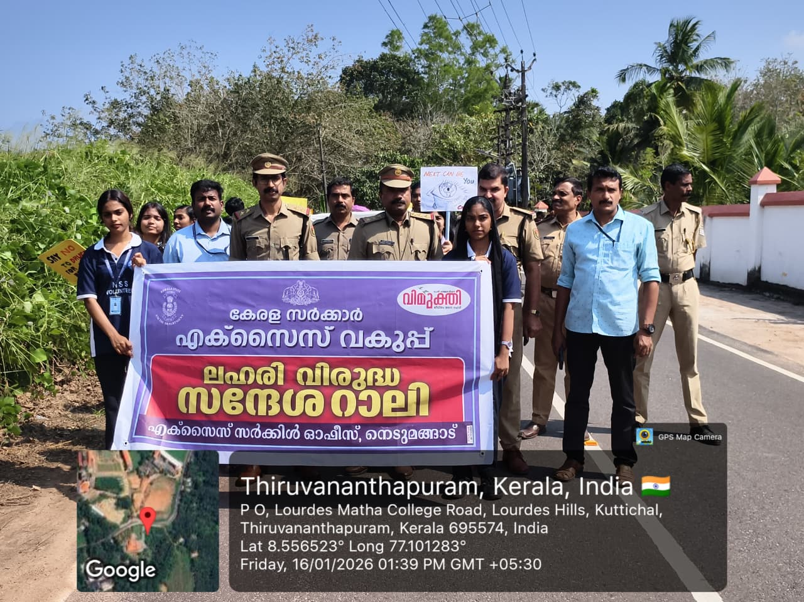
LOURDES MATHA COLLEGE OF SCIENCE AND TECHNOLOGY, KUTTICHAL, TRIVANDRUM
UNIT NO: 343
Date | 16/01/2026 | No of volunteers Participated: 58
Program | “SAY NO TO DRUGS” RALLY
Highlights of program | As part of the ongoing efforts to create awareness against substance abuse, the NSS Unit No. 343 of Lourdes Matha College of Science and Technology, Kuttichal, in association with the Excise Department, organized a “Say No to Drugs” Rally on 16 January 2026.The rally was conducted at Kuttichal from 1:30 PM to 2:00 PM. The programme aimed to spread awareness among the public, especially youth, about the harmful effects of drug abuse and the importance of leading a healthy and responsible life.The rally was led by officials from the Excise Department along with NSS volunteers. The participants marched through the main roads holding placards and banners conveying strong messages against drug abuse. Slogans promoting a drug-free society were raised, attracting public attention and encouraging community participation.The event witnessed active involvement of NSS volunteers, excise officials, and local people. The rally successfully conveyed the message of saying “No to Drugs” and reinforced the collective responsibility of society in combating substance abuse.The programme concluded peacefully at 2:00 PM, marking a meaningful step towards building a drug-free community

